Slide 1
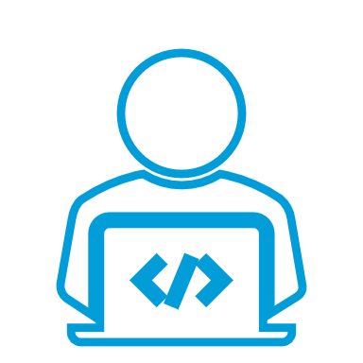
DocFinder
Web Scrapping Tool To Scrap For Doctors Data
CMSE322 GR 5
Hassan El Abdallah / Project Manager, Backend Developer
Ghaleb Mitwalle / UI Designer, Frontend Developer
Abdulaziz Binafif / Tester, System Analyst
Khawlah Alshubati / Administrator, Database Manager

Slide 2
Overview:
Introduction
Project’s aim
System actors
Use case
System architecture
Database
Scraper app
Backend
User guide of the system
App demo

Slide 3
Introduction
DOCFINDER is a Tool to Collect Doctors' Data on the Web system is a website that allows patients to easily find and interact with doctors. Patients may search for doctors based on factors such as geography and specialty and examine provider profiles to make educated healthcare decisions.

Slide 4
Project’s Aim
Build a comprehensive database of doctors and their professional information by extracting and collecting data from various medical websites and databases, so it will be easy for patients to search for what they want by filtering their search to have better results.

Slide 5
System actors
System Admin is the person who manages the database of the system.
System Scraper is responsible for scraping websites to update doctors’ data.
System User is the website visitor who searches for doctors’ information.

Slide 6
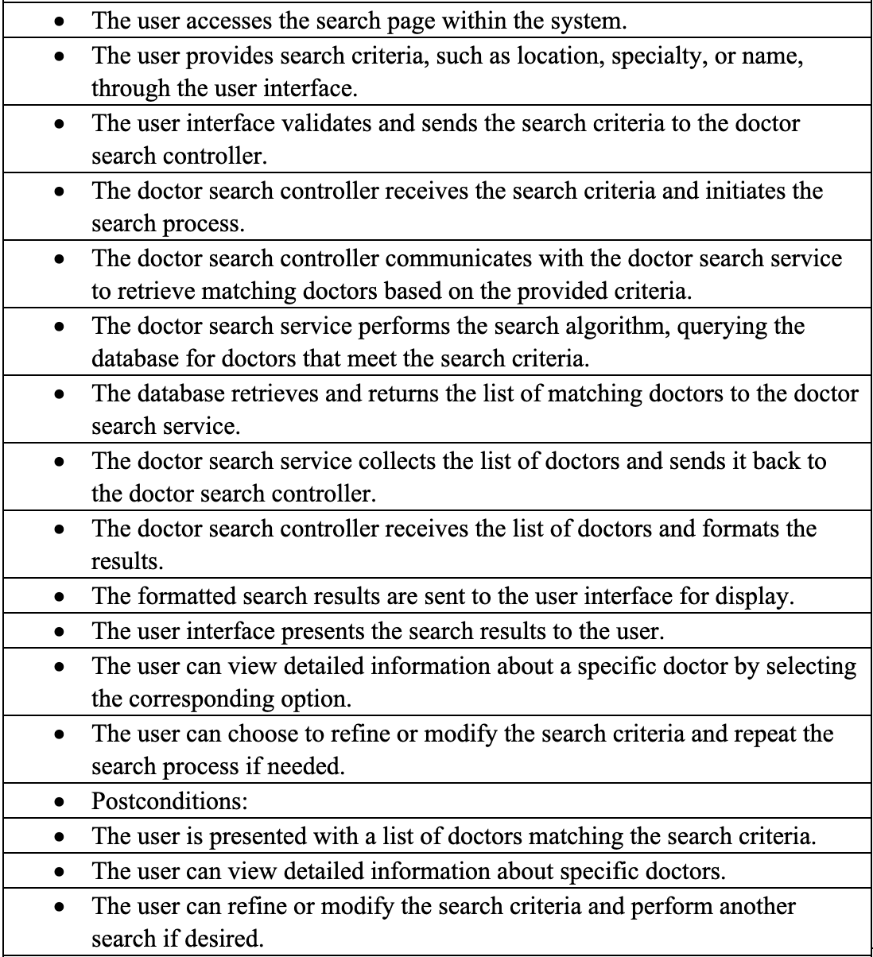
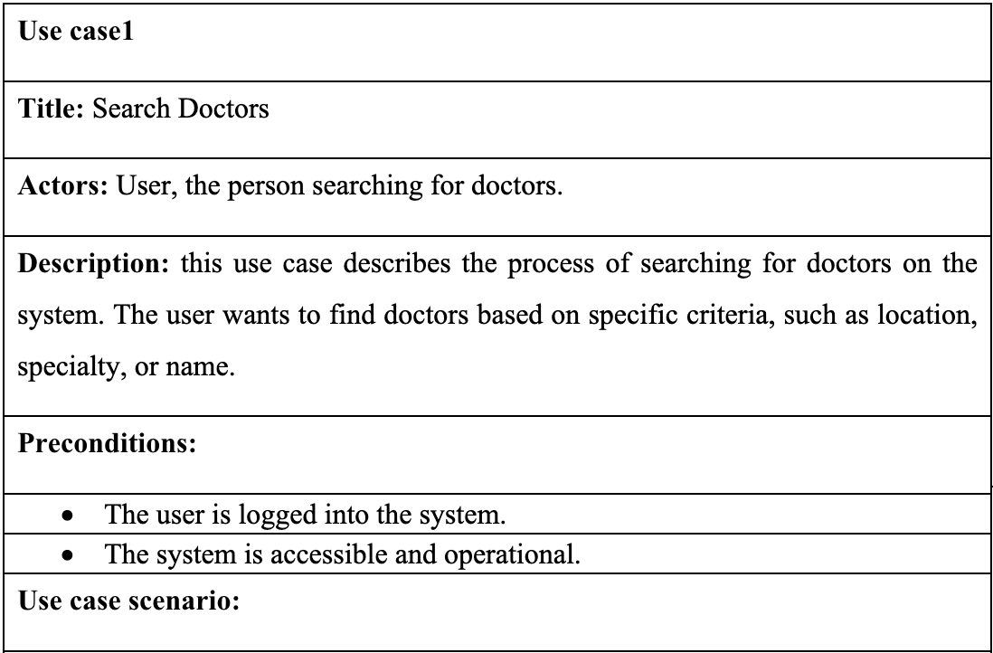
Use case

Slide 7
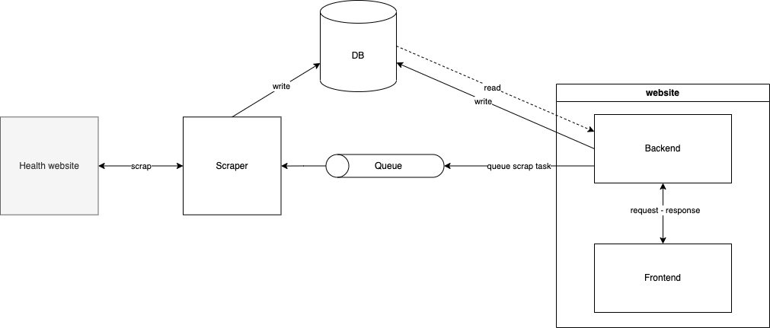
System architecture

Slide 8
Database
Module 1

Slide 9
Database - Tools
MySql as a database management system to the store data
Sequelize library in the backend to interact with the database and write queries
Mysql-connector library in scraper to write scraped data into database

Slide 10
Database - Modules
Clinics: stores information about healthcare clinics.
Doctors: contains information about medical professionals.
Reviews: stores information about user reviews or feedback regarding doctors.
Specialties: stores information about medical specialties or areas of expertise.
Users: stores information about individuals who interact with the system.

Slide 11
Database - Relationships
Doctors and clinics one-to-many relationship, where each clinic has many doctor, and each doctor has only one clinic.
Doctors and specialties one-to-many relationship, where each doctor has only one specialty, and each specialty could have many doctors.
Doctors and profiles one-to-one relationship, where each doctor has only one profile, and each profile relates to only one doctor.
Doctors and reviews one-to-many relationship, where each doctor has many reviews, and each review relates to only one doctor.
Users and reviews one-to-many relationship, where each user has many reviews, and each review relates to only one user.

Slide 12
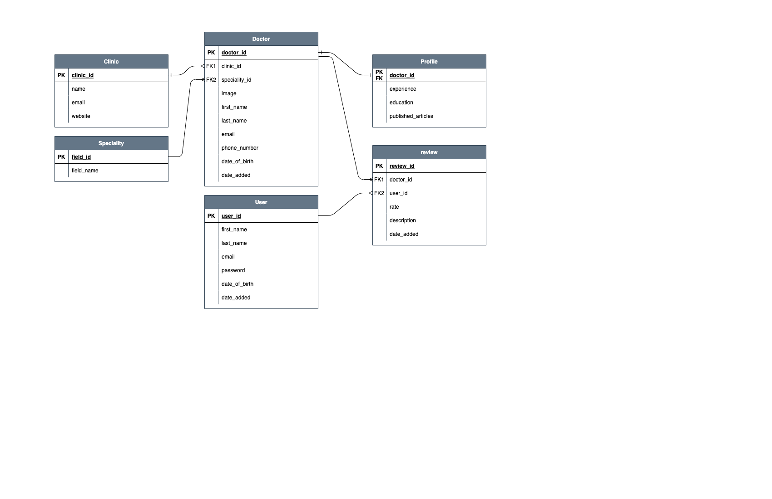
Database - Tables

Slide 13
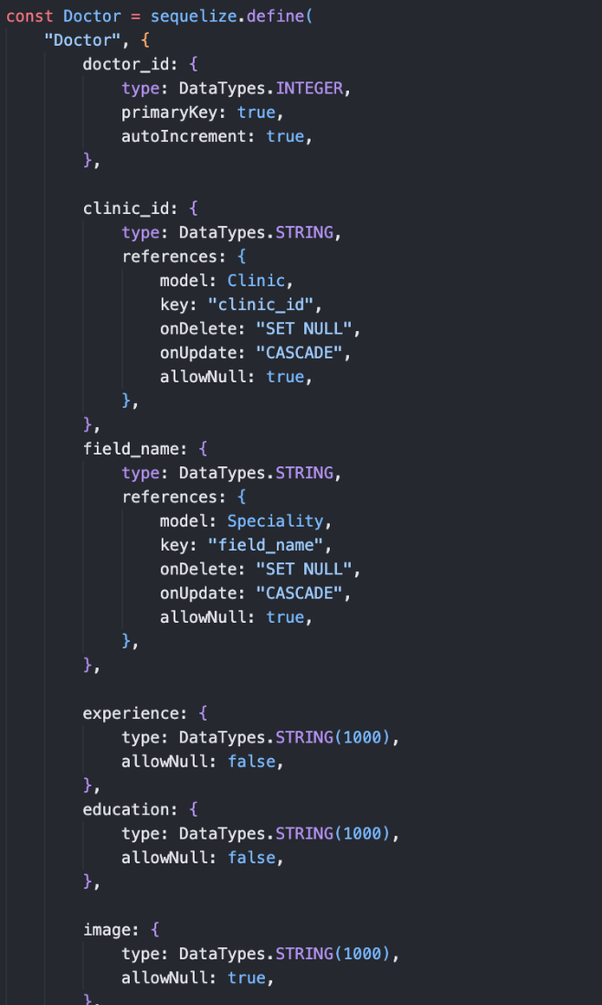
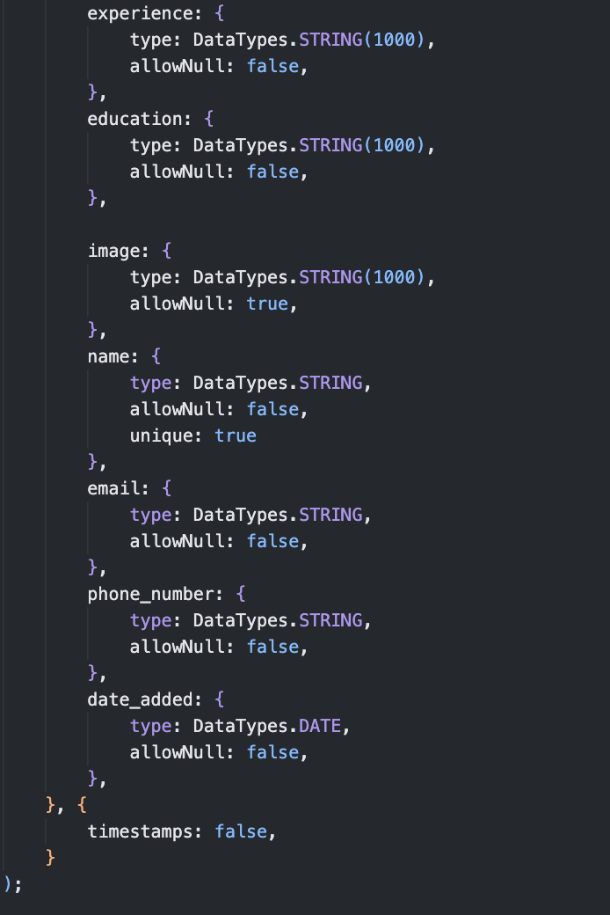
Physical Database
CREATE TABLE IF NOT EXISTS `Doctors` (
`doctor_id` INTEGER auto_increment,
`clinic_id` VARCHAR(255),
`field_name` VARCHAR(255),
`experience` VARCHAR(1000) NOT NULL,
`education` VARCHAR(1000) NOT NULL,
`image` VARCHAR(1000),
`name` VARCHAR(255) NOT NULL UNIQUE,
`email` VARCHAR(255) NOT NULL,
`phone_number` VARCHAR(255) NOT NULL,
`date_added` DATETIME NOT NULL,
PRIMARY KEY (`doctor_id`),
FOREIGN KEY (`clinic_id`) REFERENCES `Clinics` (`clinic_id`),
FOREIGN KEY (`field_name`) REFERENCES `Specialities` (`field_name`)
) ENGINE=InnoDB;

Slide 14
Scrapper
Module 2

Slide 15
Scraper - Tools
Python as the core programming language for the app
Beautifulsoap library to scrap the data from other websites
Celery library to receive queued tasks and manage worker processes

Slide 16
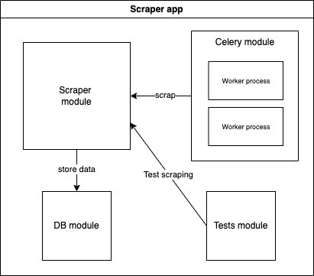
Scraper - architecture

Slide 17
Scraper - modules
Scraper module is the core module of the app where it’s responsible for to visit health websites and collect doctors info, and pass it to DB module.
DB module is responsible for receiving data from scraper module and, validate them, and then store them in to the database.
Celery module acts as a consumer to receive scrap tasks from the backend, and then assign worker process to handle it.

Slide 18
backend
Module 3

Slide 19
Backend - Tools
NodeJS as a runtime environment to run javascript on the backend
ExpressJS framework to run a web server
AMQPLIB library to queue scraping tasks to the scraper app

Slide 20
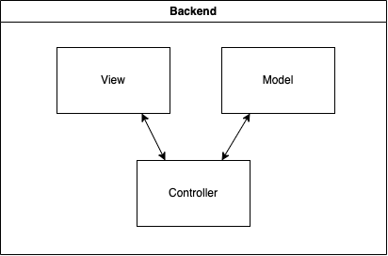
Backend - architecture

Slide 21
Backend - MVC
Model represents the data and business logic of the application. It encapsulates the data and provides methods to access and manipulate it.
View is responsible for presenting the data to the user and rendering the user interface.
Controller acts as an intermediary between the model and the view. It receives user input from the view and translates it into actions to be performed on the model.

Slide 22
User guide
Module 4

Slide 23
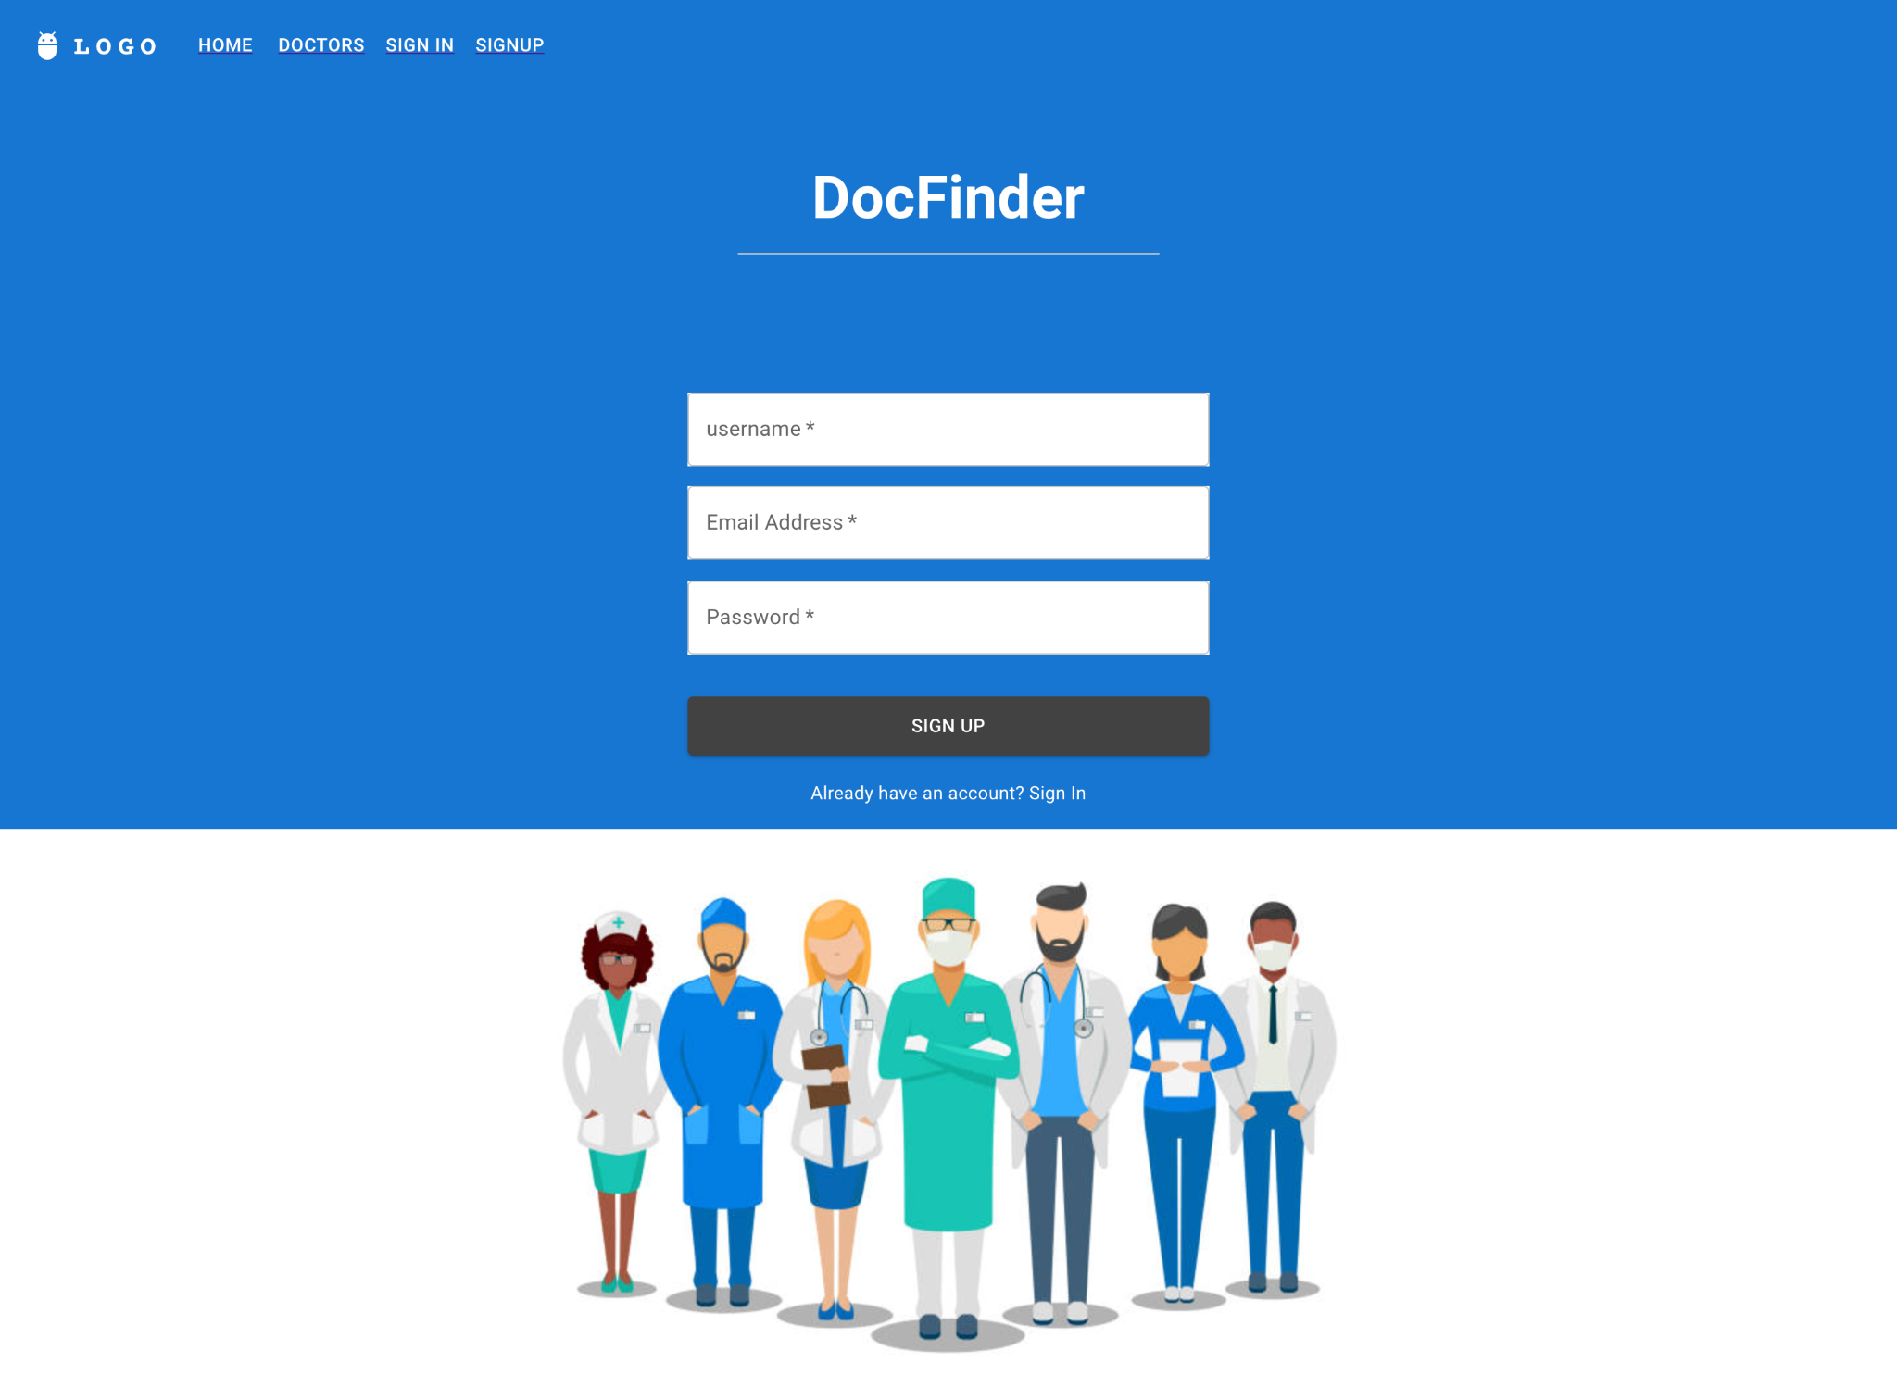
User guide of the system
First the user will have sign in/up by providing authentication credentials, such as username, email, and password.

Slide 24
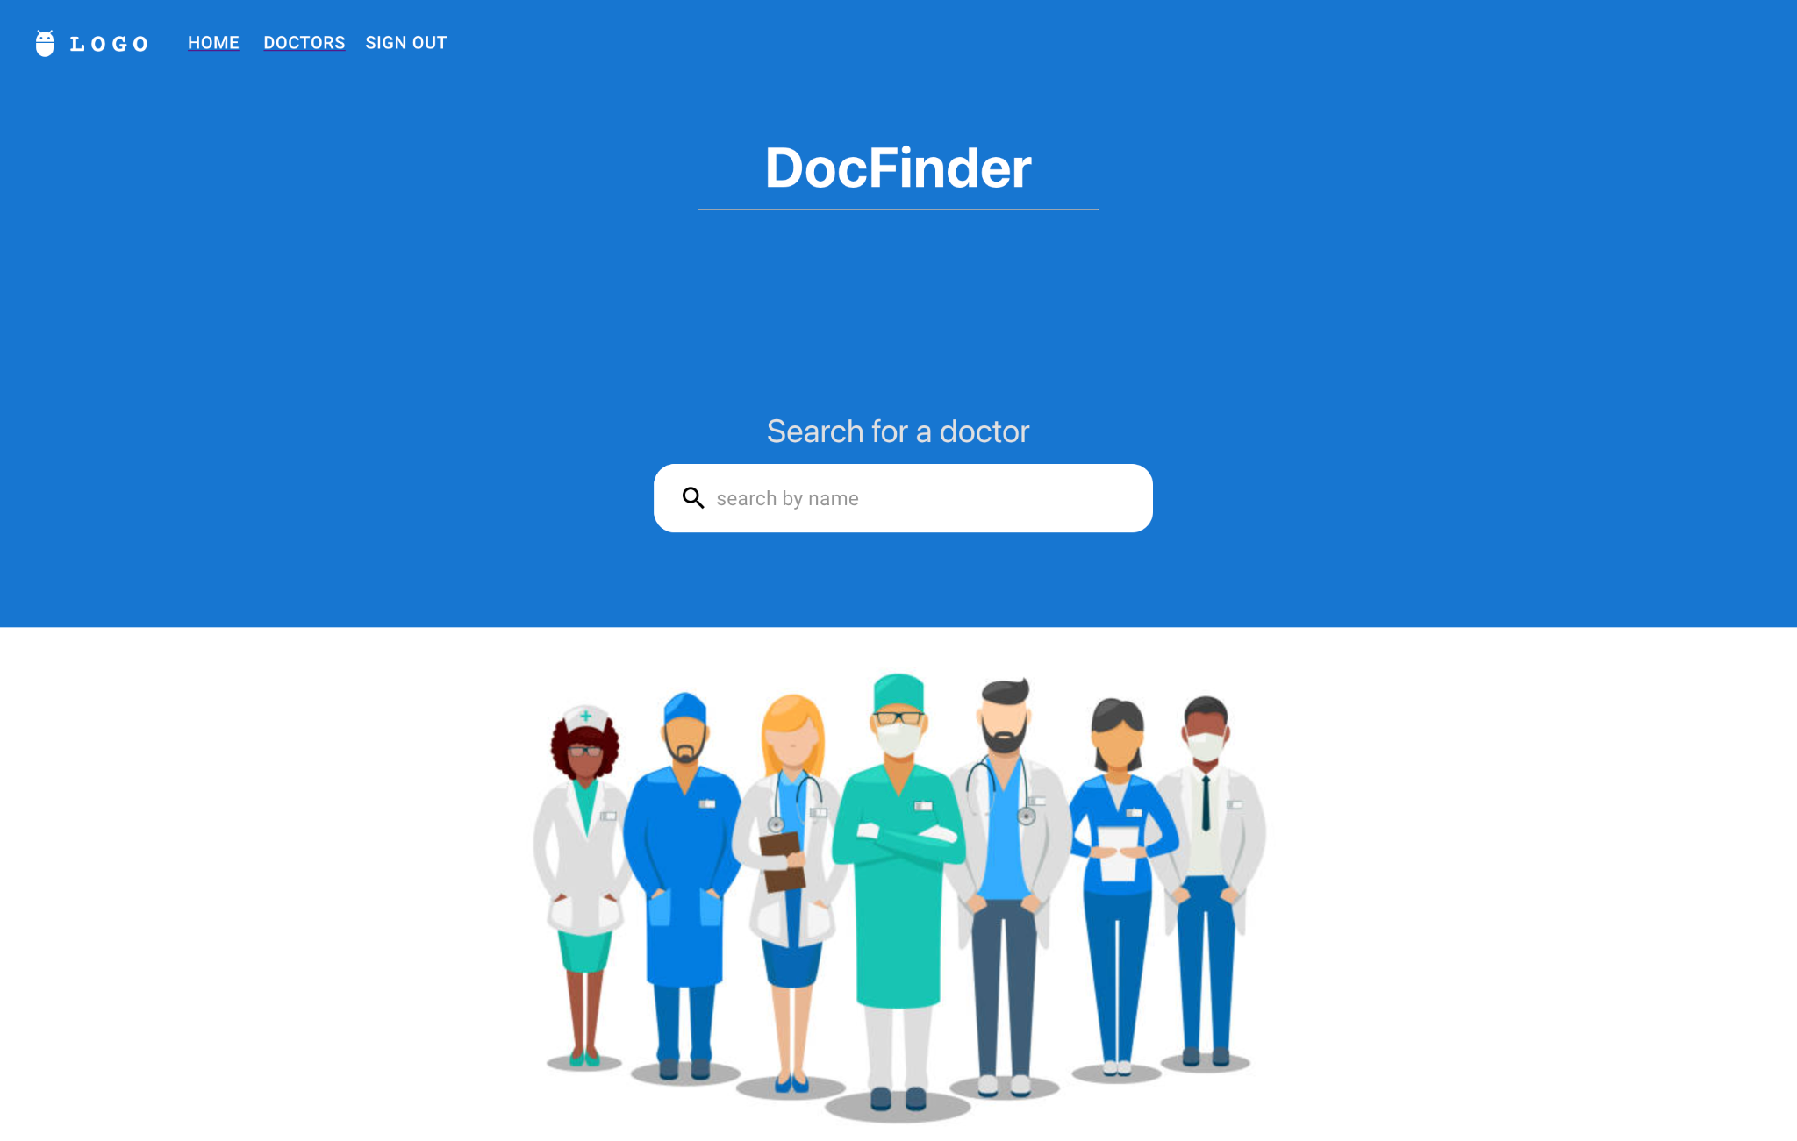
User guide of the system
User can click on the search bar to search
doctor by name.

Slide 25
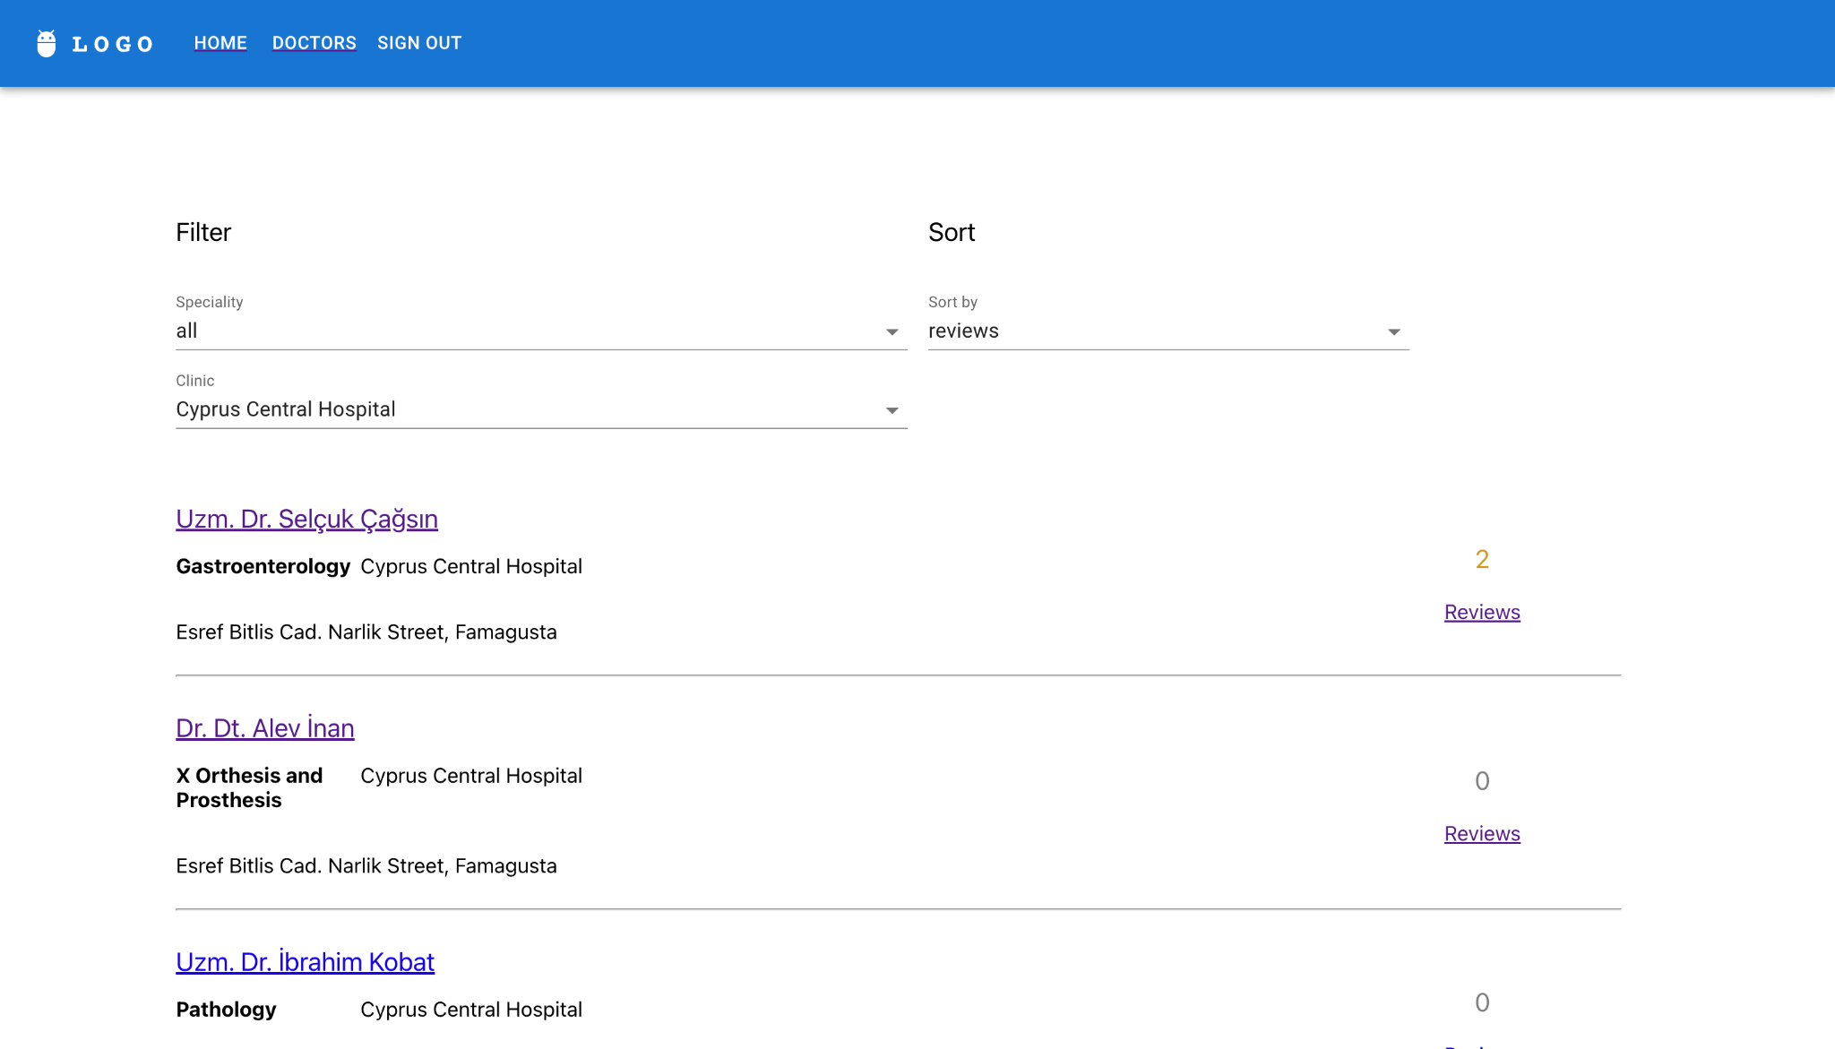
User guide of the system
Or user can go to doctors list page, where he/she will be able to filter doctors by speciality/clinic, and order them by review rate.

Slide 26
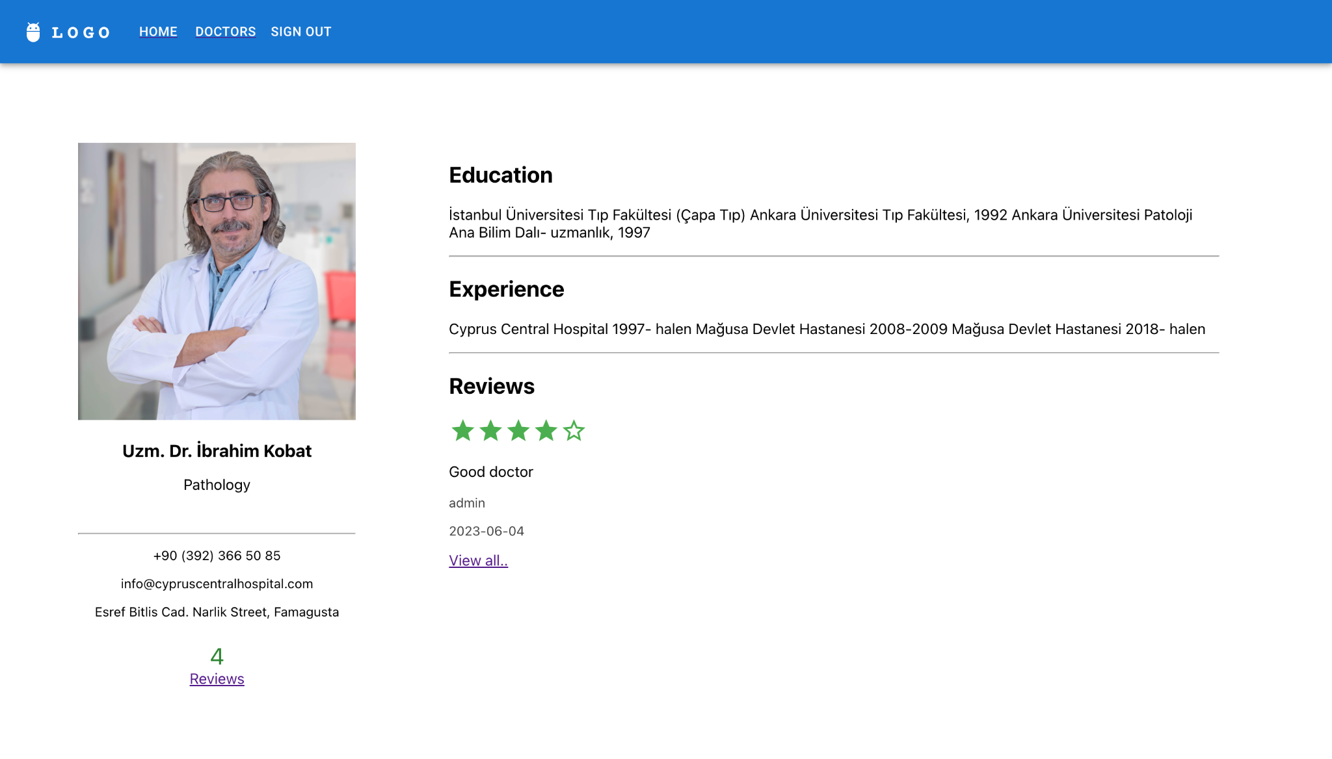
User guide of the system
User can click on a doctor name to go into doctor details, where he/she can find doctor’s profile, such as education, experience, etc…

Slide 27
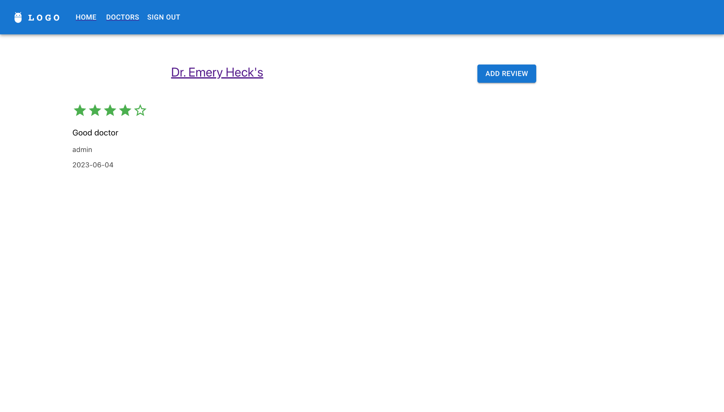
User guide of the system
Then user can go to reviews page, to check the reviews, which include a rate out of 5 start, and a comment to the doctor.

Slide 28
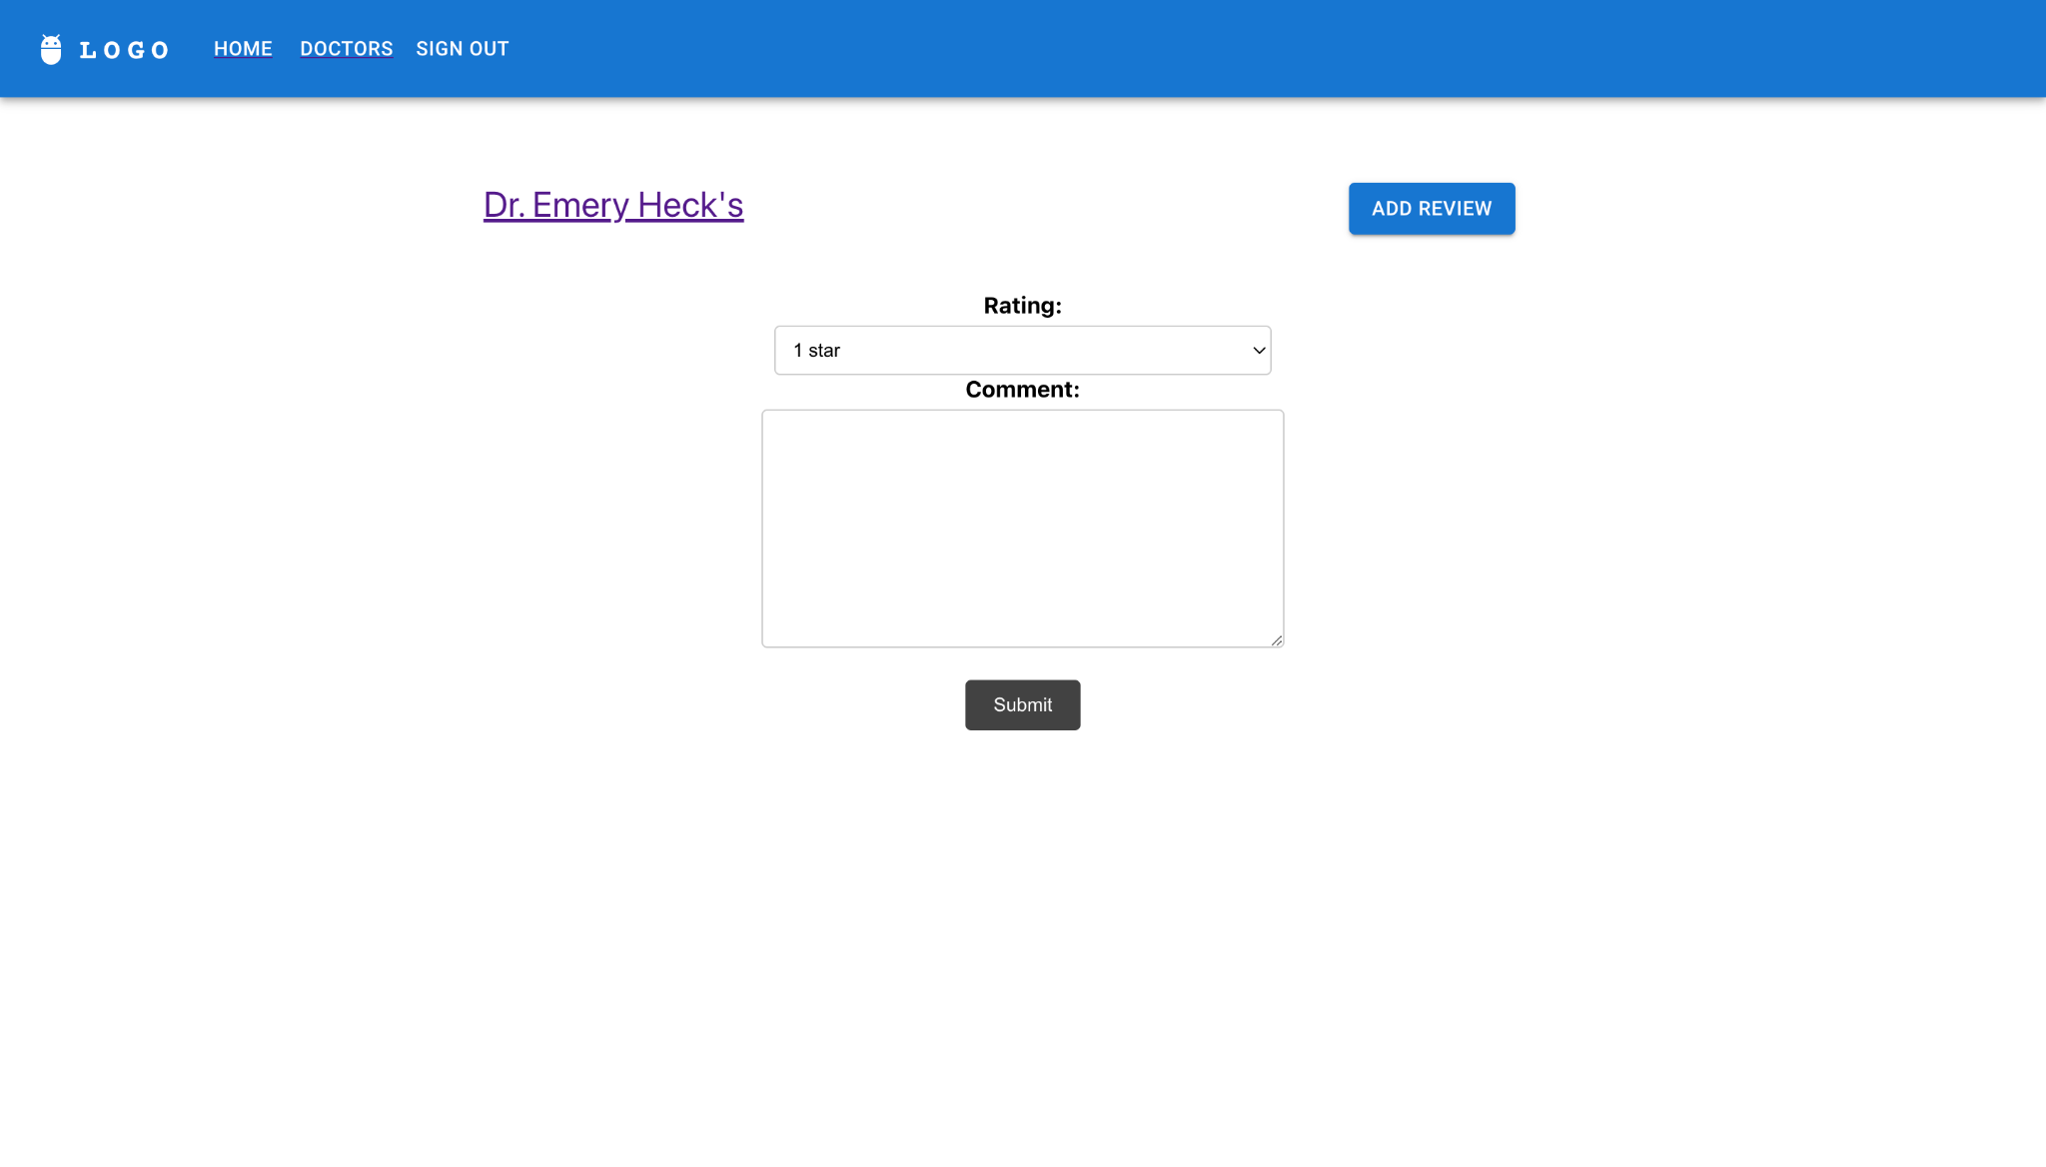
User guide of the system
User can add a new review for this doctor, by adding rate out of 5, and a comment. Note that if user is not signed in, he/she will be redirected to sign in page.

Slide 29
Demo
Main part

Slide 30
App demo
https://github.com/hsnkh12/doctors-scraper-app
https://github.com/hsnkh12/cmse322-backend
https://github.com/hsnkh12/cmse322-frontend

Slide 31
Thank you
Assit.Prof.Dr. Duygu Celik

